Slide 1


Case study : 5 – Sustainable Agriculture with AI for Crop Yield Prediction
Leveraging AI for Smarter Farming

Slide 2
TEAM
MOHANPRASANTH R (TEAMLEADER _S4F_CP_TEAM_11783)
BARATH G ( TEAM MEMBER _S4F_CP_TEAM_11783)
NAVEENKUMAR K S ( TEAM MEMBER_S4F_CP_TEAM_11783)
SANTHOSHKUMAR S ( TEAM MEMBER _ S4F_CP_TEAM_11783)
PRASATH V ( TEAM MEMBER _S4F_CP_TEAM_11783)

Slide 3
Content
Abstract
Problem Statement
Objective
Data Collection and Preparation
Proposed Solution (Methodology)
Model Performance Evaluation
Screenshots / Demonstration (video)
Future Scope
Conclusion
Notes:
Abstract
Problem Statement (Clearly define the challenge)
Objective (State your project's goal)
Background and Research (Discuss existing solutions, trends, and gaps)
Data Collection and Preparation (Focus on data sources, cleaning, and augmentation)
Proposed Solution (Methodology)
Model Architecture (e.g., CNN, U-Net, YOLOv5)
Key Techniques (e.g., Transfer Learning, Image Augmentation)
Model Performance Evaluation
Metrics (Accuracy, Precision, Recall, IoU, etc.)
Graphs (Confusion Matrix, ROC Curve, etc.)
Screenshots / Demonstration (Visual proof of system functionality)
Future Scope (Improvements, scalability, and integration ideas)
Conclusion (Summarize results and impact)
Q&A Session

Slide 4
Abstract
Climate change affects agriculture
AI-based solutions can improve crop yield prediction
Our project builds a predictive model using soil and weather data
Goal: Optimize resources, improve sustainability

Slide 5
Problem Statement
Agriculture is highly dependent on environmental factors Climate change disrupts traditional farming methods Farmers need data-driven tools for better decision-making AI can analyze large datasets to predict yields

Slide 6
Objective
Develop an AI model for crop yield prediction
Use soil and weather data to improve forecasting
Help farmers make informed decisions
Enhance sustainability and resource efficiency

Slide 7
Data Collection and Preparation
1. Data Sources:
Historical crop yield data
Soil quality (pH, nutrients)
Weather data (temperature, rainfall)
2. Pre-processing:
Cleaning, handling missing values
Formatting time-series data
3. Exploratory Data Analysis (EDA):
Heat maps, scatter plots, correlation matrices

Slide 8
Proposed Solution (Methodology)
1. Model Selection:
We used Random Forest.
2. Feature Engineering:
Soil quality (e.g., nitrogen, pH), weather conditions
Time-based factors (seasonality)
3. Model Training & Evaluation:
Train/test split, hyper parameter tuning
Cross-validation

Slide 9
Model Performance Evaluation
1. Metrics Used:
Mean Squared Error (MSE), Root Mean Squared Error (RMSE)
2. Feature Importance:
Key variables influencing predictions
3. Results:
Comparison of actual vs. predicted yields

Slide 10
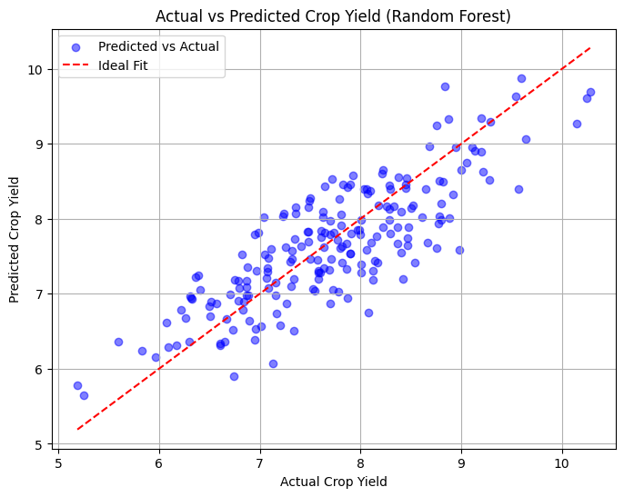
Screenshots / Demonstration (video)
GitHub Link: https://github.com/Mohan1008r/AI-GREENSKILLS-CASE-STUDY-5-

Slide 11
Future Scope
lot Integration: Real-time data collection
Advanced AI Techniques: Deep learning, satellite data
Global Expansion: Adapt model for different regions
Climate Adaptation: Suggest resilient crops

Slide 12
CASE STUDY-5
QUESTIONS & ANSWERS

Slide 13
Case Study: AI in Sustainable Agriculture for Crop Yield Prediction
1. How can AI help farmers increase crop yields while reducing environmental impact?
AI enhances agricultural productivity while minimizing environmental harm through precision farming, predictive analytics, and automated decision-making. AI models analyze factors like soil health, weather conditions, and past yield data to help farmers optimize irrigation, fertilization, and planting schedules. AI-powered smart irrigation systems reduce water usage by up to 30%, while AI-driven pest and disease detection helps farmers reduce pesticide overuse. By leveraging AI, farmers can increase yields while conserving natural resources.

Slide 14
2. How can we develop a model to predict crop yields based on soil and weather data?
To build a crop yield prediction model, follow these steps:
Data Collection – Gather data on soil quality, rainfall, temperature, fertilizer use, and past crop yields.
Data Preprocessing – Clean data, handle missing values, and normalize numerical features.
Feature Selection – Identify key factors influencing yield, such as pH levels, nitrogen content, and precipitation.
Model Selection – Train AI models such as Random Forest, Support Vector Machines (SVM), or Neural Networks.
Model Training & Testing – Split data into training (80%) and testing (20%), then train the model.
Performance Evaluation – Measure accuracy using Mean Absolute Error (MAE), Root Mean Squared Error (RMSE), and R² Score.
Deployment – Implement the trained model in mobile apps or dashboards for real-time predictions.

Slide 15
3. What steps can farmers take based on the model’s predictions to optimize their resources?
Farmers can use AI-driven predictions in multiple ways : Optimize Water Usage – Use AI-powered irrigation systems to avoid overwatering or under watering crops .Efficient Fertilization – Adjust fertilizer levels based on AI recommendations to prevent soil degradation. Smart Planting Schedules – Determine the best time to plant based on weather predictions. Crop Rotation Planning – Follow AI-guided rotation patterns to maintain soil fertility. Pest & Disease Prevention – Apply pesticides only when AI detects potential threats, reducing chemical overuse.

Slide 16
4. How can AI solutions contribute to global food security?
AI addresses food security challenges by : Reducing Food Waste – Predicting optimal harvest times to minimize spoilage. Improving Yield Predictions – Helping governments and organizations plan food distribution effectively. Enhancing Climate Resilience – Assisting farmers in adapting to changing climate conditions. Optimizing Supply Chains – AI tracks demand trends to prevent food shortages and overproduction. Boosting Productivity – AI-driven farming techniques increase yields by 10-20%, ensuring enough food for growing populations.

Slide 17
5. How can AI promote sustainable agricultural practices in developing countries?
AI can empower smallholder farmers by providing :AI-Powered Mobile Apps – Real-time farming advice on weather, pest control, and soil health . Drone & Satellite Monitoring – AI-powered drones detect crop diseases early, reducing pesticide reliance. Affordable AI Advisory Systems – AI chatbots provide personalized farming recommendations in local languages. Precision Irrigation – Smart AI-controlled irrigation systems conserve water and improve efficiency. Automated Pest Detection – AI models identify pest infestations early, preventing large-scale crop losses.

Slide 18
Conclusion
AI can optimize farming decisions
Helps reduce resource waste & improve sustainability
Supports global food security
Future advancements can further enhance precision farming

